Slide 1
Complexity Analysis of Recurrence Relation
Md. Muktar Hossain
Lecturer
Dept. of CSE
Varendra university

Slide 2

Definition
A recurrence relation is a mathematical expression that defines a sequence in terms of its previous terms.
General form of a Recurrence Relation:
$a_{n}=f(a_{n−1}$, $a_{n−2}$, ... $a_{n−k})$
Example:
Fibonacci Sequence | F(n) = F(n-1) + F(n-2)
Factorial of a number n | F(n) = n * F(n-1)
Merge Sort | T(n) = 2*T(n/2) + O(n)
Binary Search | T(n) = T(n/2) + 1

Slide 3
Solving Technique
Solving recurrences plays a crucial role in the analysis, design, and optimization of algorithms.
There are mainly three ways of solving recurrences:
Substitution Method
Recurrence Tree Method (Study yourself)
Master Method

Slide 4
Substitution Method
It uses following steps to find Time Complexity using recurrences:
Take the main recurrence and try to write recurrences of previous terms
Take just previous recurrence and substitute into main recurrence
Again take one more previous recurrence and substitute into main recurrence
Do this process until you reach to the initial condition
After this substitute the the value from initial condition and get the solution

Slide 5
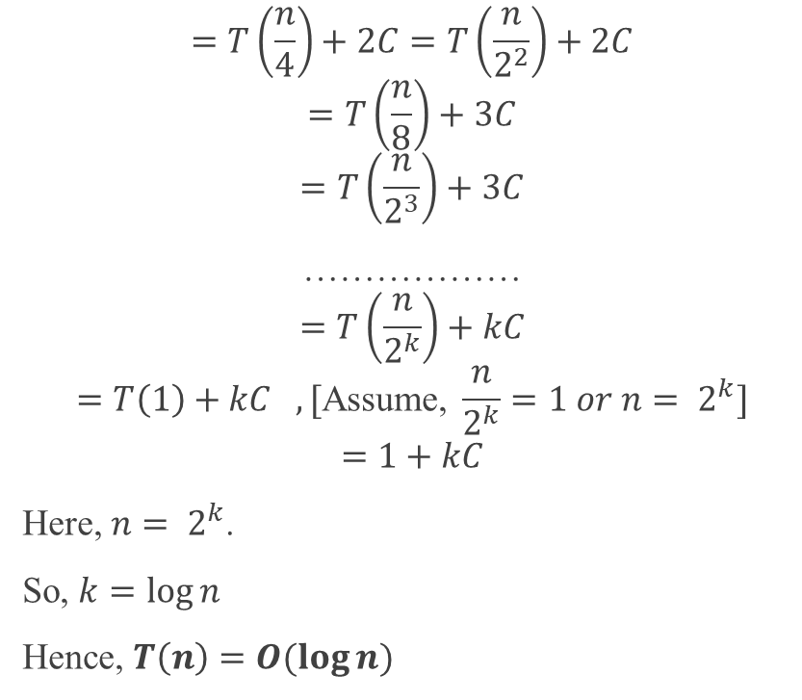
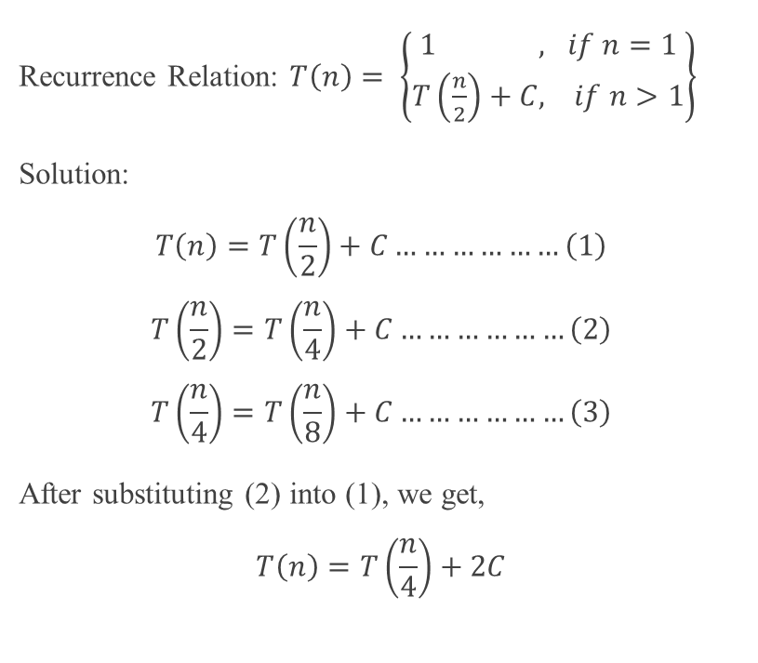
Substitution Method Cont’d
Recurrence Relation: $T\left(n\right)= \left\{\begin{aligned}1 , if n=1 \\ T\left(\frac{n}{2}\right)+C, if n>1\end{aligned}\right\}$
Solution:
$$T\left(n\right)=T\left(\frac{n}{2}\right)+C………………\left(1\right)$$
$$T\left(\frac{n}{2}\right)=T\left(\frac{n}{4}\right)+C………………\left(2\right)$$
$$T\left(\frac{n}{4}\right)=T\left(\frac{n}{8}\right)+C………………\left(3\right)$$
After substituting (2) into (1), we get,
$$T\left(n\right)=T\left(\frac{n}{4}\right)+2C$$
$$=T\left(\frac{n}{4}\right)+2C=T\left(\frac{n}{2^{2}}\right)+2C$$
$$=T\left(\frac{n}{8}\right)+3C$$
$$=T\left(\frac{n}{2^{3}}\right)+3C$$
………………
$$=T\left(\frac{n}{2^{k}}\right)+kC$$
$$=T\left(1\right)+kC ,[\text{Assume}\text{, }\frac{n}{2^{k}}=1 or n= 2^{k}]$$
$$=1+kC$$
Here, $n= 2^{k}$.
So, $k=\log{n}$
Hence, $T\left(n\right)=O(\log{n)}$

Slide 6

Substitution Method Cont’d
Calculate the Big-O notation of the following recurrences using Substitution method:
$T\left(n\right)= \left\{\begin{aligned} 1 , if n=1 \\ 2T\left(\frac{n}{2}\right)+n, if n>1\end{aligned}\right\}$
$T\left(n\right)= \left\{\begin{aligned} 1 , if n=1 \\ n∗T\left(n−1\right), if n>1\end{aligned}\right\}$

Slide 7
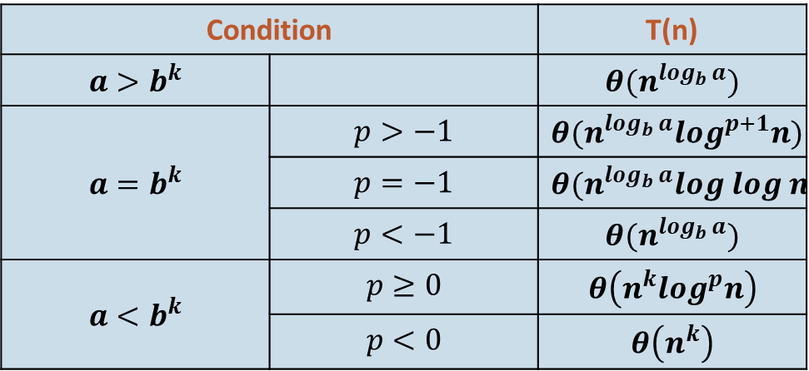

Master Method (Theorem)
Usually used for divide and conquer algorithm.
Required Form:
$T\left(n\right)=aT\left(\frac{n}{b}\right)+f\left(n\right) or T\left(n\right)=aT\left(\frac{n}{b}\right)+θ\left(n^{k}\log^{p}n\right) , where a≥1, b>1, k≥0$
Solution:
Condition |  | T(n)
$${a>b}^{k}$$ |  | $${θ(n}^{\log_{b}{a}})$$
$${a=b}^{k}$$ | $$p>−1$$ | $${θ(n}^{\log_{b}{a}}\log^{p+1}n)$$
 | $$p=−1$$ | $${θ(n}^{\log_{b}{a}}log log n)$$
 | $$p<−1$$ | $${θ(n}^{\log_{b}{a}})$$
$${a<b}^{k}$$ | $$p≥0$$ | $$θ\left(n^{k}\log^{p}n\right)$$
 | $$p<0$$ | $$θ\left(n^{k}\right)$$
Here, n = size of the problem a = number of sub-problems and a >= 1 n/b = size of each sub-problem b > 1, k >= 0 and p is a real number.

Slide 8


Master Method Cont’d
Recurrence Relation: $T\left(n\right)= \left\{\begin{aligned}1 , if n=1 \\ T\left(\frac{n}{2}\right)+C, if n>1\end{aligned}\right\}$
Solution:
Here, a = 1, b = 2, k = 0, p = 0.
a = 1 = 2⁰ = b^{k} and p > -1.
So,
$${\text{T}\text{(}\text{n}\text{) =} θ(n}^{\log_{2}{1}}\log^{0+1}n)$$
$${\text{=} θ(n}^{0}\log{n})$$
$$\text{=} θ (log{n})$$
Recurrence Relation: $T\left(n\right)= \left\{\begin{aligned} 1 , if n=1 \\ 3T\left(\frac{n}{2}\right)+\log^{2}n, if n>1\end{aligned}\right\}$
Solution:
Here, a = 3, b = 2, k = 0, p = 2.
a > 1 = 2⁰ = b^{k}
So,
$${\text{T}\text{(}\text{n}\text{) =} θ(n}^{\log_{2}{3}})$$
For more Examples, click here.

Slide 9

Master Method Cont’d
Calculate the Big-O notation of the following recurrences using Master method:
$T\left(n\right)= \left\{\begin{aligned} 1 , if n=1 \\ 2T\left(\frac{n}{2}\right)+n, if n>1\end{aligned}\right\}$
$T\left(n\right)= \left\{\begin{aligned} 1 , if n=1 \\ 8T\left(\frac{n}{2}\right)+n^{2}, if n>1\end{aligned}\right\}$
$T\left(n\right)= \left\{\begin{aligned} 1 , if n=1 \\ 3T\left(\frac{n}{2}\right)+n^{2}, if n>1\end{aligned}\right\}$

Slide 10
Thank You

